Slide 1
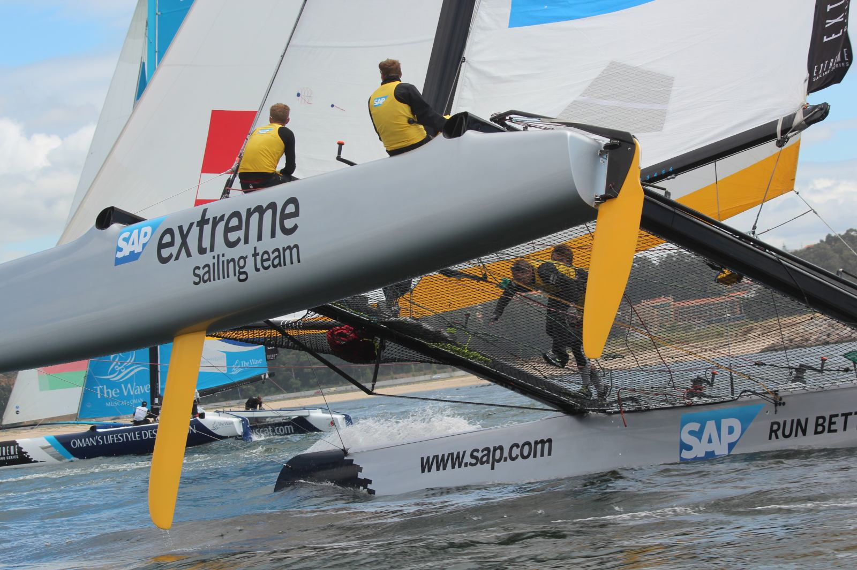

SAP Sailing Analytics
Introduction to System Operations
Axel Uhl, Global Sponsorships
January, 2016

Slide 2
Agenda
Introduction to SAP Sailing Analytics
Overview Functions, Features, and Architecture
First Steps in the Administration Console
Enabling Users
Creating an Event
Adding a Simple Regatta with a Leaderboard
Adding Competitors
Entering Scores
Using the Race Manager App
Binding a Device
Logging On
Planning and Running a Race
Regularly Updating Wind Data

Slide 3
Agenda
Advanced Event and Regatta Settings
Uploading Images and Videos
Using the Media Gallery
Setting Event Images for Stage, Logo and Teaser
Adding Video Playback to a Race Replay
Regatta Format and Scoring Options
Race Manager App Configuration (Start Procedures, Course Options, …)
Importing Results from an External Source (e.g., Manage2Sail)
Edit Mark Position Mask
Smartphone Tracking for Single-Fleet Regattas
Defining the Course Marks and Waypoints
Inviting and Binding Competitors’, Marks’ and Mark Layers’ Devices
Using the SAP Sail InSight Tracking App
Pinging Marks
Starting and Stopping a Race

Slide 4
Agenda
Smartphone Tracking for Split-Fleet Regattas
Defining Series and Fleets in the Regatta
Assigning Competitors to their Fleet Races
Smartphone Tracking for Split-Fleet Regattas with per race boat mappings
Register boats for a regatta with split-fleet racing
Register Competitors with per race boat assignments
Map competitors to boats per race
Track boats
Known Issues, Outlook
Importing Competitors from External Regatta Management System
Using Race Manager-Based Result Entry and External Scoring System
Correcting Wrongly Pinged Mark Positions
Obtaining the Apps
User Management

Slide 5
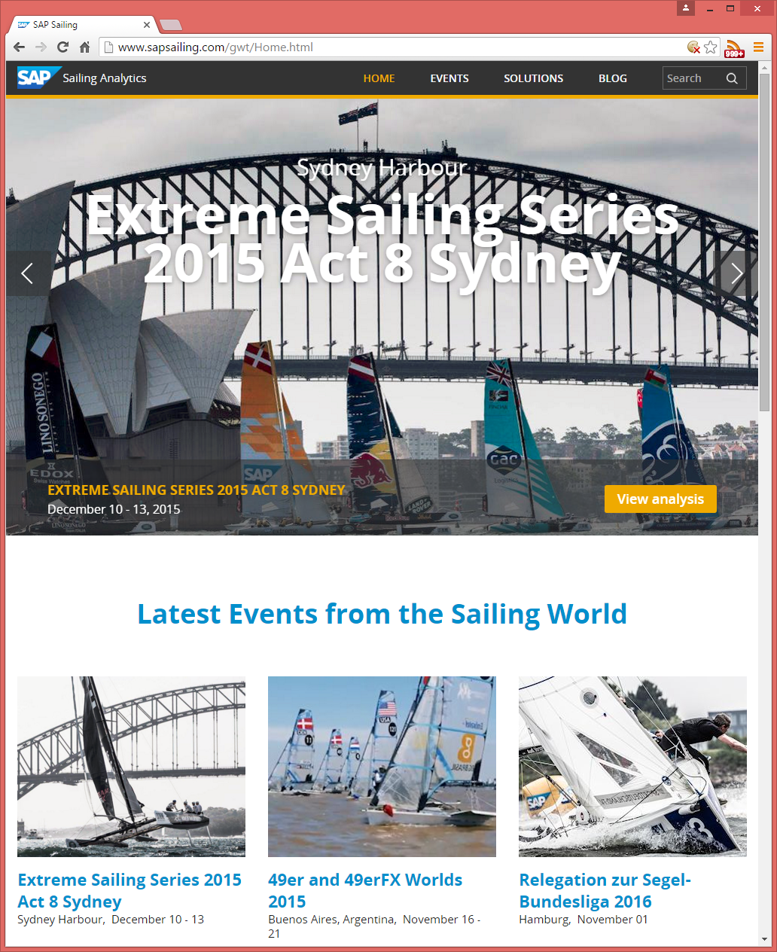
SAP Sailing Analytics – Overview
Live Events and Rich Archive for Sailing Regattas
Hundreds of Sailing Events
Thousands of Races Tracked
All of them with Live Tracking at the Time
Race Management Support
App helps organizers to stay on top of the event
Live Scoring, Live Leaderboards, Live Analyses
Audience Information about Schedules, Updates
So far available only to SAP-Sponsored events.
Now SAP Sailing Analytics “go Club”

Slide 6
SAP Sailing Analytics – Top Features
Live Events and Rich Archive for Sailing Regattas
Hundreds of Sailing Events
Thousands of Races Tracked
All of them with Live Tracking at the Time
Race Management Support
App helps organizers to stay on top of the event
Live Scoring, Live Leaderboards, Live Analyses
Audience Information about Schedules, Updates
So far available only to SAP-Sponsored Events
Now SAP Sailing Analytics “go Club”

Slide 7
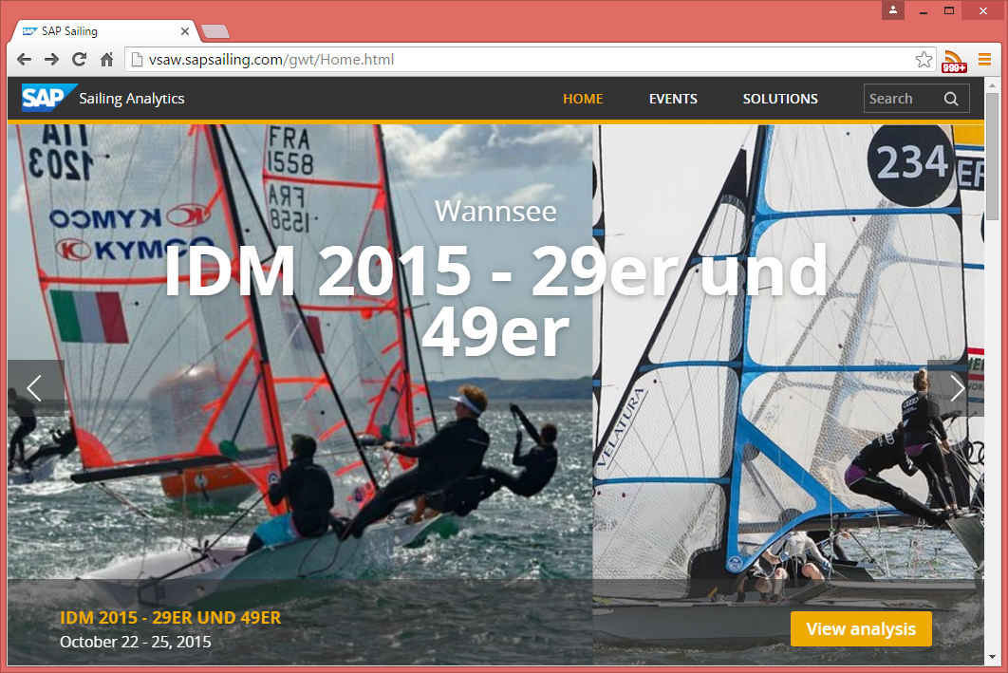
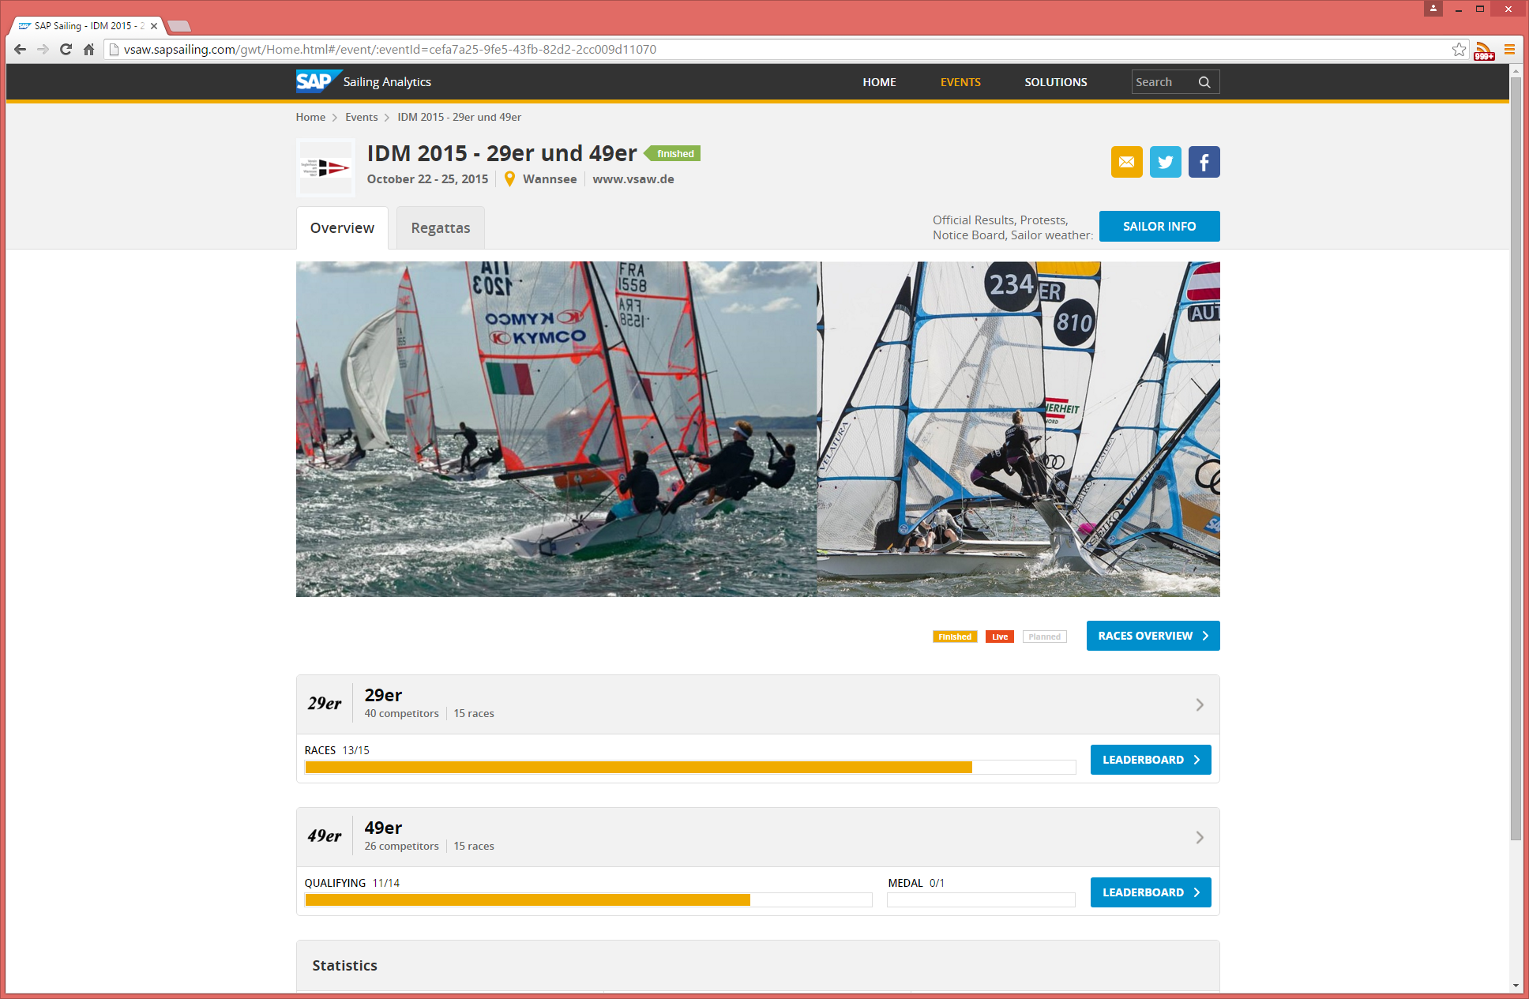
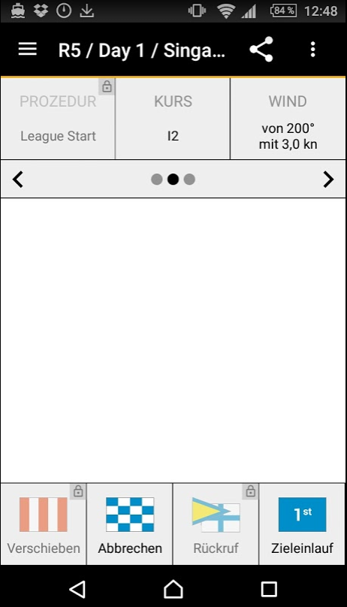
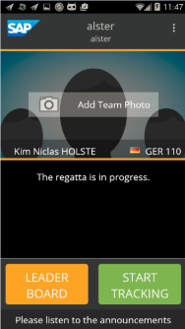
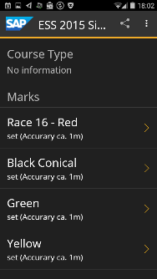
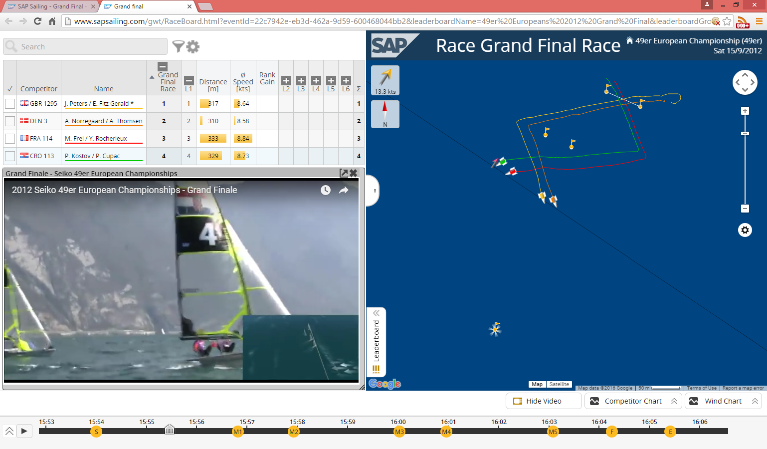
SAP Sailing Analytics – What’s in it for Your Club?
Feature your own Space
Advertise your own Events in Nice Web Site
Manage your own Regattas
Race Management App for Schedules / Scoring
Keep Audience up to date
Get a Beautiful Web Site for your Event Quickly
Support Live Tracking using Smart Phones
Link Video Footage to Tracked Races

Slide 8
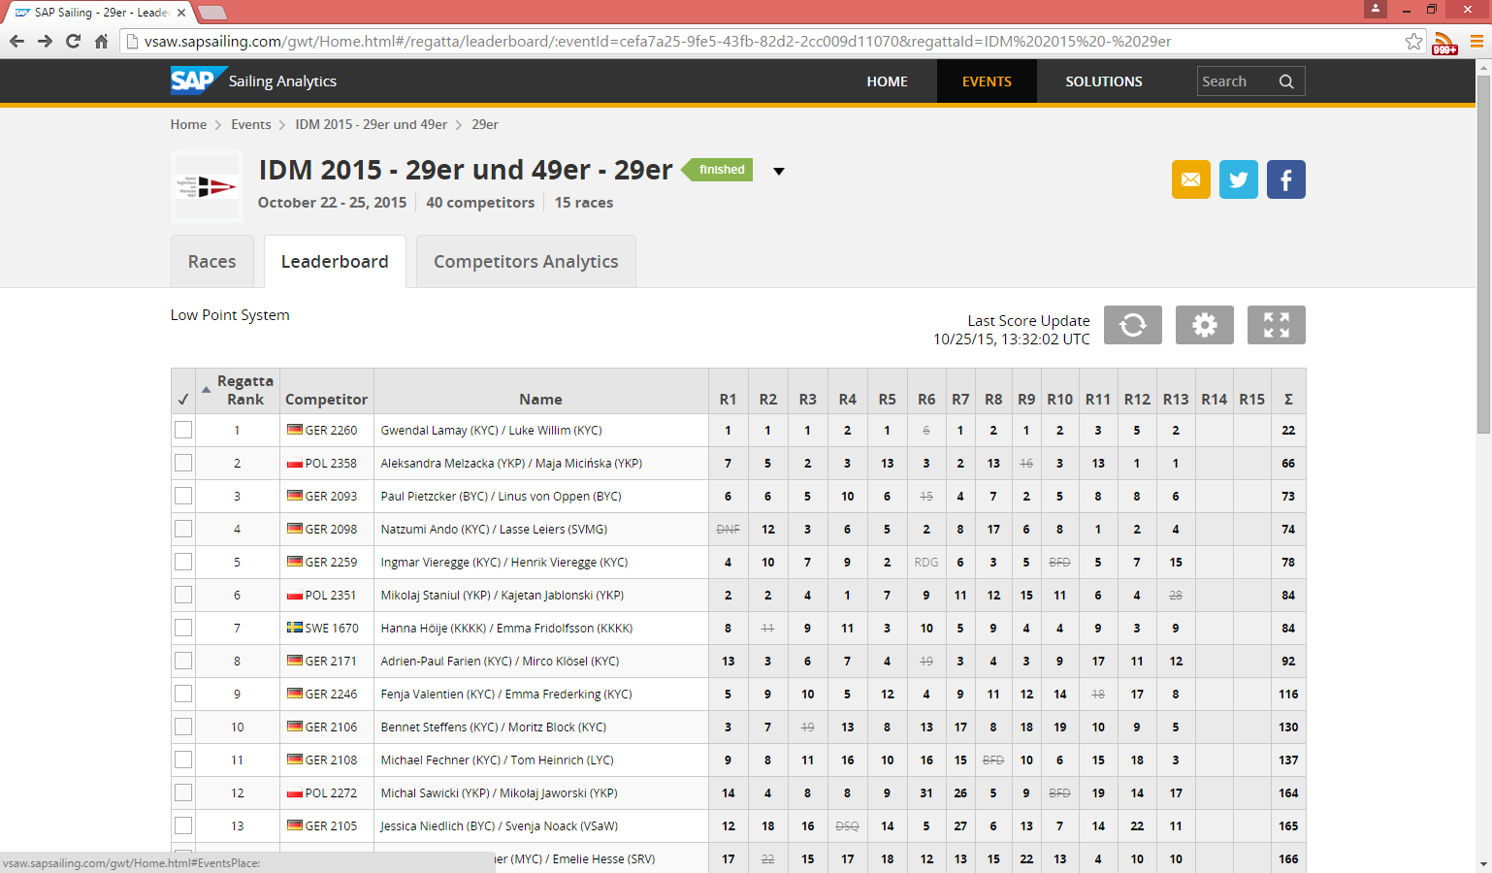
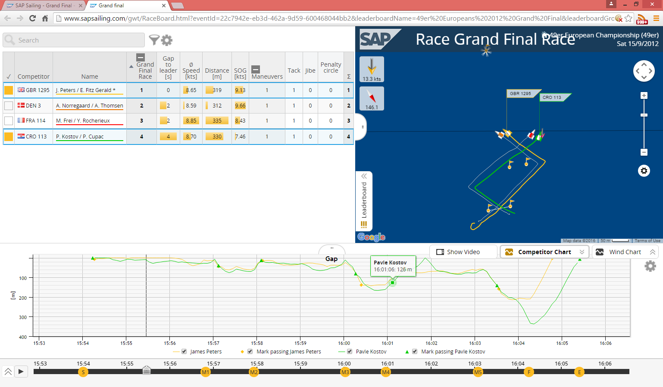
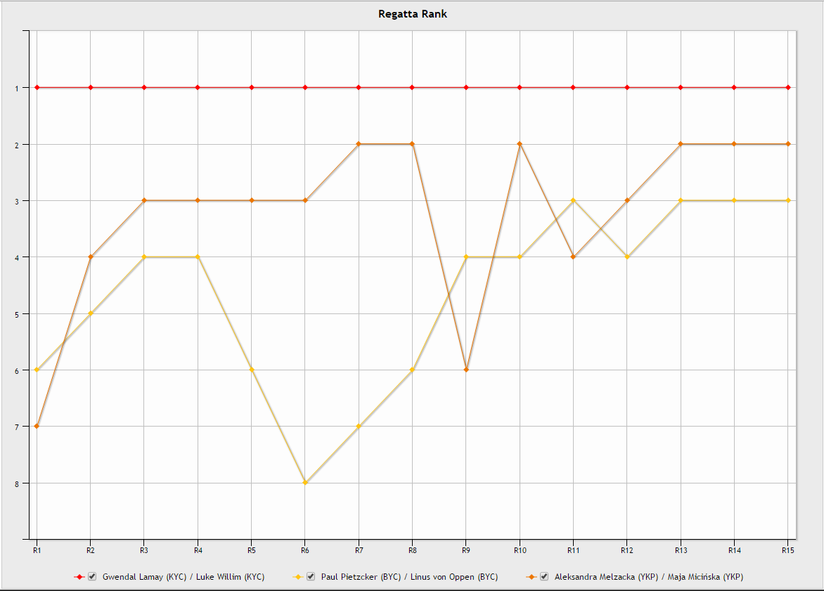
SAP Sailing Analytics – Live Leaderboards
Live Leaderboards
Based on Race Manager App at Race Finish
Live In-Race Ranking when Tracking in Place
Supporting Handicap Formulas (ToT, ToD)
Live Statistics
Ranks, Points (w/o Tracking), Gap, Speed, …

Slide 9
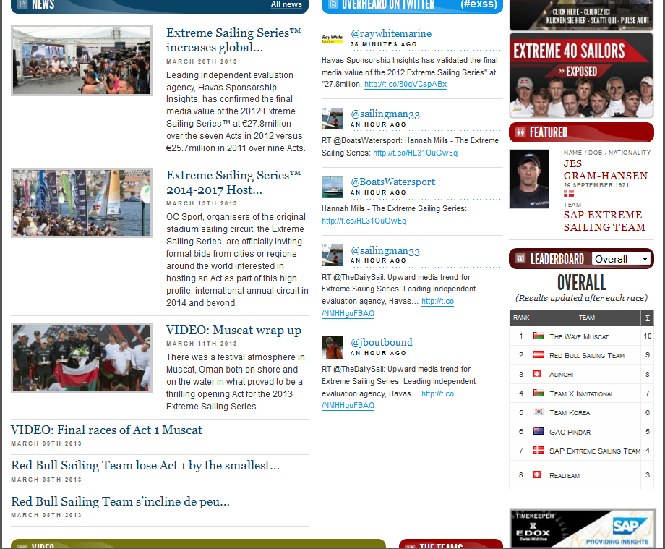
Embedding Leaderboard Content in Other Web Pages
JSON RESTlets to feed the Live Regatta and Series Leaderboards
Needs to mention SAP

Slide 10




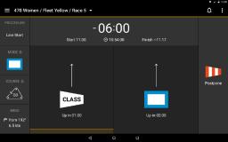
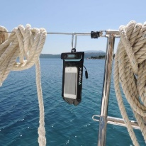
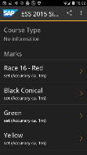


How Does It Work?
sapsailing.com
WindBot
HTTP
End User
GSM/3G
GSM/3G
HTTP
Operator
Buoy Pinging App
Race Manager App
Sail InSight App

Slide 11
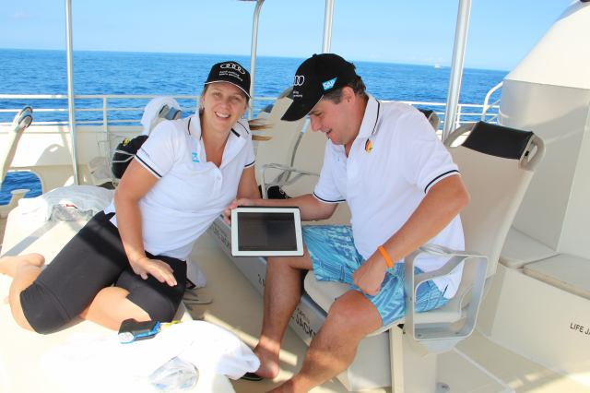
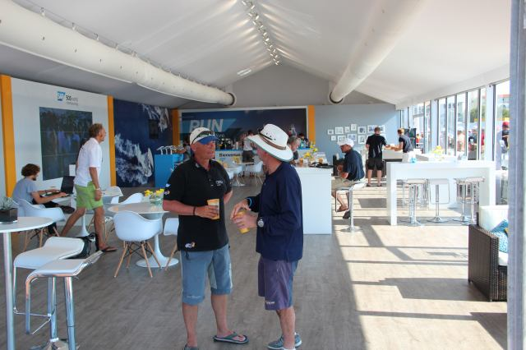
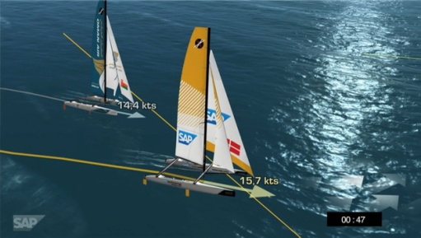
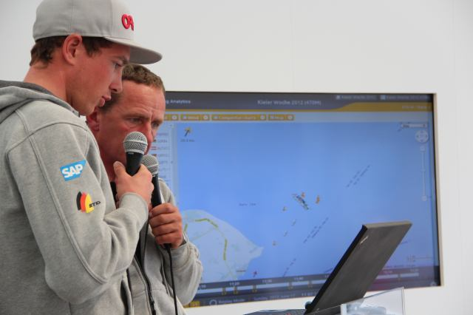
Typical Event Set-Up
Hospitality Program with Spectator Boats
Live Race Analytics shown to spectators on tablets
Lounge, Club Facilities
tablets, big screens, projector / canvas
On-Shore Viewers
Online live program with scheduled racing times and course areas
Live 2D / 3D Course and Race Visualization on shore
Live Internet streaming with commentary
Sailors Debrief using the SAP Sailing Analytics

Slide 12
More Background
http://www.youtube.com/watch?v=PDYLMWiB0Uw
http://www.youtube.com/watch?v=e4pUfNkrOa8
http://www.youtube.com/watch?v=w2hclkxZEoY
http://www.youtube.com/watch?v=8S2FOSWs_U0
http://www.youtube.com/watch?v=BjvSUpv6A4A
https://wiki.wdf.sap.corp/wiki/display/NWI/SAP+Sailing+Program

Slide 13
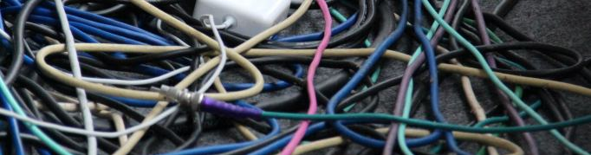
Questions?

Slide 14
Agenda
Introduction to SAP Sailing Analytics
Overview Functions, Features, and Architecture
First Steps in the Administration Console
Enabling Users
Creating an Event
Adding a Simple Regatta with a Leaderboard
Adding Competitors
Entering Scores
Using the Race Manager App
Binding a Device
Logging On
Planning and Running a Race
Regularly Updating Wind Data

Slide 15
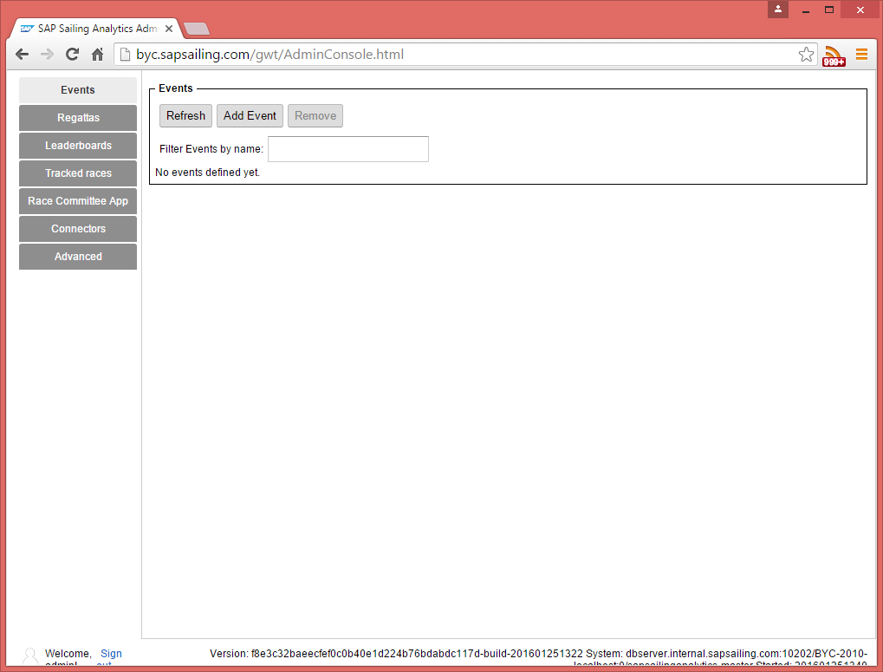
Logging On
http://yourserver.sapsailing.com/gwt/AdminConsole.html
User: admin
Password: admin
Shows initial, empty event list
Go to Advanced→User Management

Slide 16
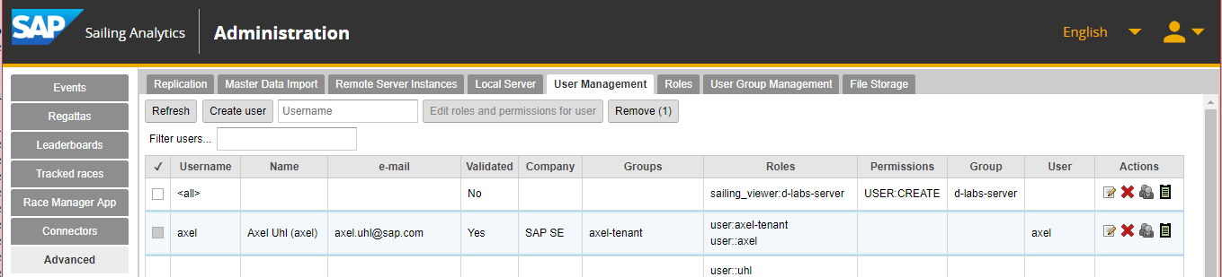
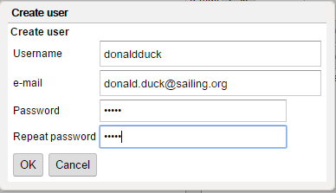
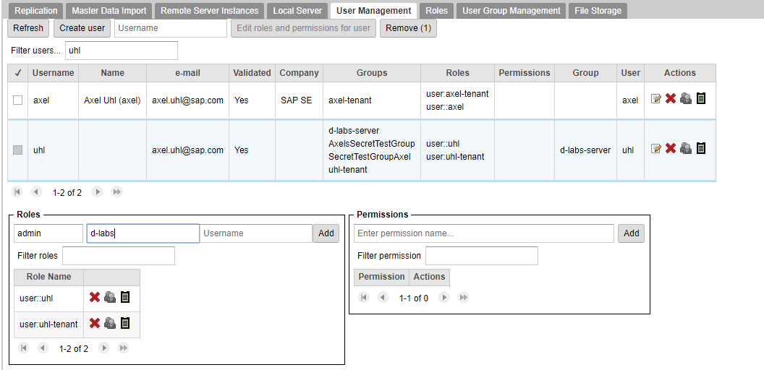
Adding and Enabling Users
Click “Create User”
Enter user details, press OK
User receives validation e-mail
Add “admin” role for user, qualified for server group

Slide 17
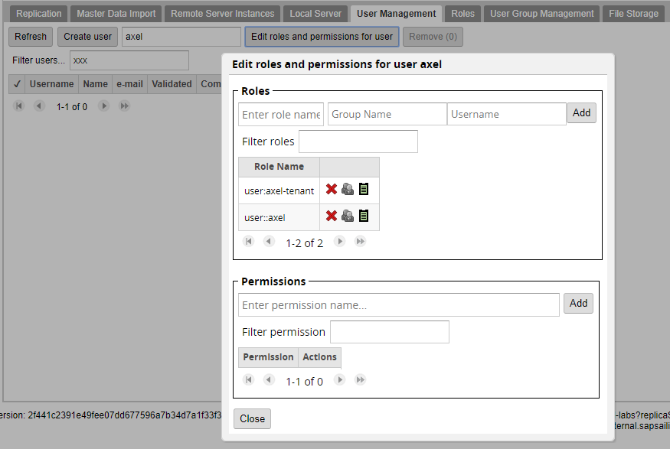
Enabling Users already Signed Up
To enable any user, even if not visible for you in the list:
Enter user name and press “Edit roles and permissions for user”
If the user exists, the dialog to maintain roles and permissions opens up
Again, add the “admin” role qualified with the server / event group

Slide 18
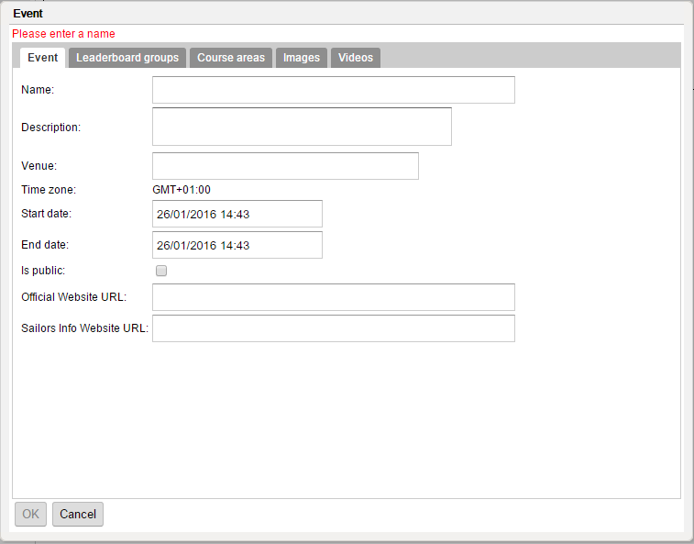
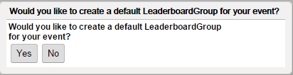
Adding an Event
In “Events” tab click “Add Event”
Fill in name, description, venue, start and end date
A default course area
Press OK to create the event. Choose “Yes” to create Leaderboard Group

Slide 19
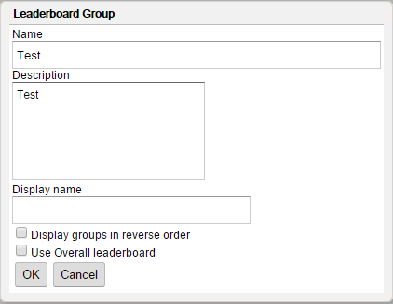
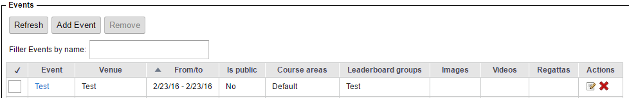
Adding a “Leaderboard Group”
A “Leaderboard Group” can describe
A part of a larger event (e.g., “International Classes” at “Kieler Woche”)
A series of events, such as for a league (Extreme Sailing Series, Bundesliga)
Needed also for single-class, single event set-ups
Optionally adjust the fields
Name (has to be globally unique)
Description
Optionally fill in a (usually shorter) display name
Press OK
The Leaderboard group is created and added to the new event

Slide 20
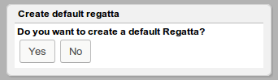
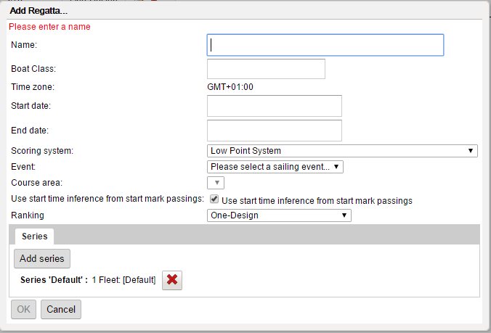
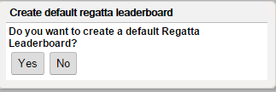
Adding a Regatta
Choose “Yes” to create a default Regatta
Fill in the fields
Name
Boat Class
Event (select the one created before)
Course Area (select the auto-created “Default”)
Press OK
Press OK on the “Add Regatta…” dialog
In the popup “Create default regatta leaderboard” press “Yes”
The regatta has one series with one fleet and no races yet

Slide 21
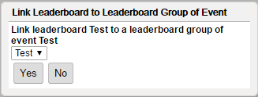
Linking Regatta Leaderboard to Event Leaderboard Group
Press OK on the popup dialog that suggests to link the regatta leaderboard to the event’s leaderboard group

Slide 22
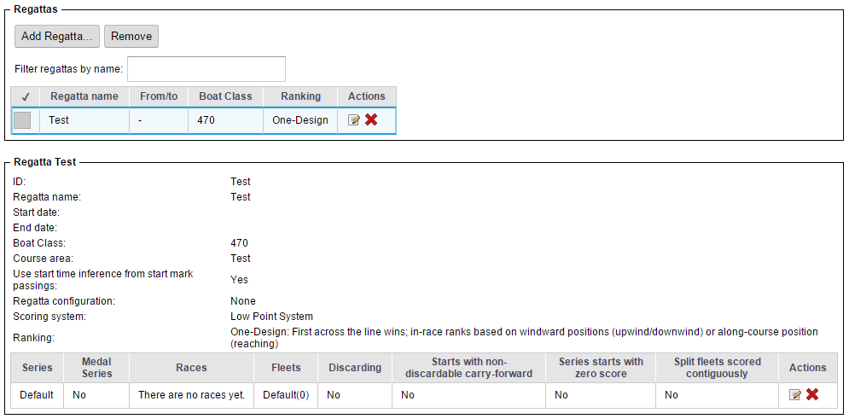
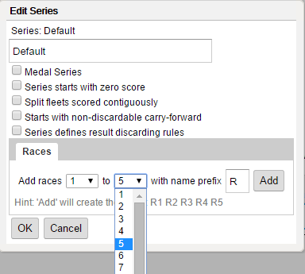
Adding Races to the Regatta
Select regatta (1)
Click “Edit” icon for Default series (2)
In the “to” drop-down, select number of races to add (3)
Click “Add” (4)
Click “OK” (5)
1
2
3
4
5

Slide 23
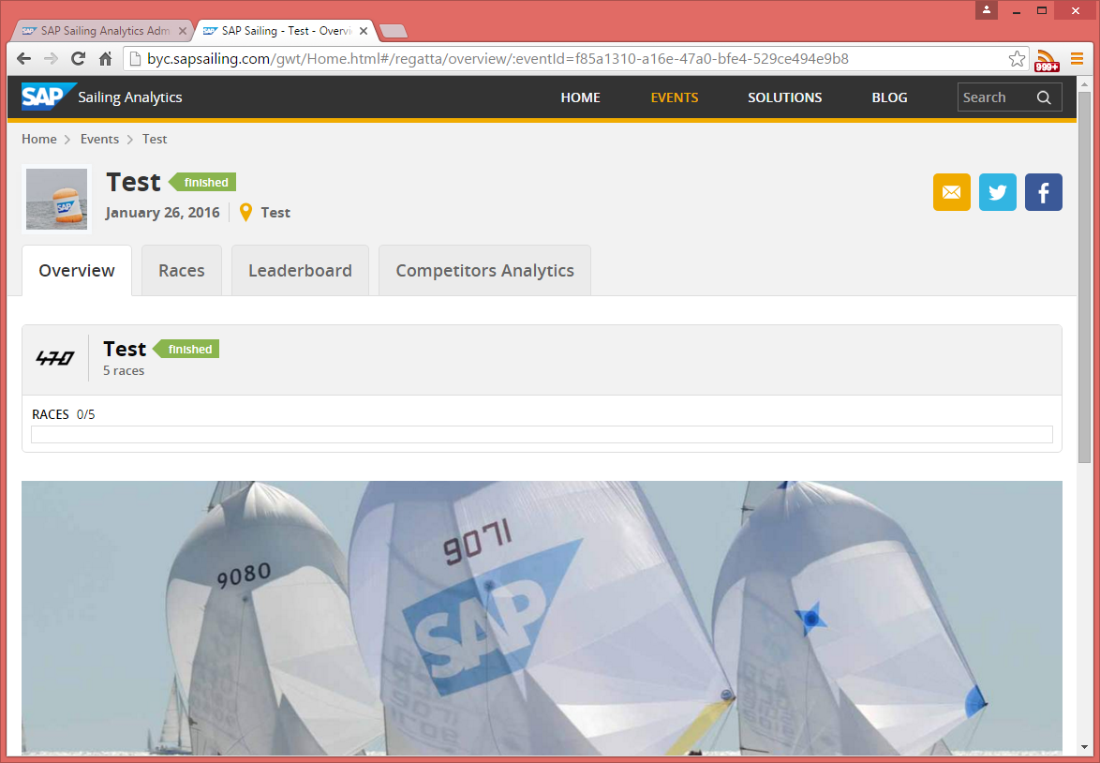
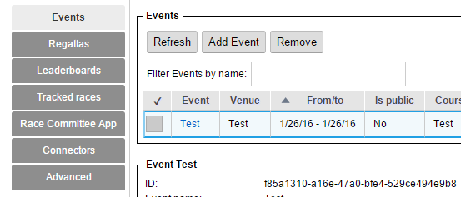
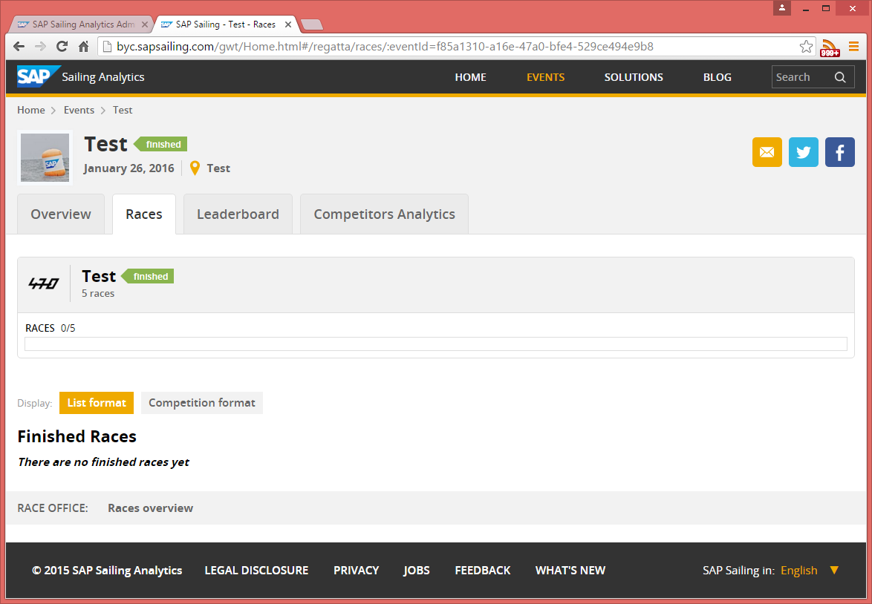
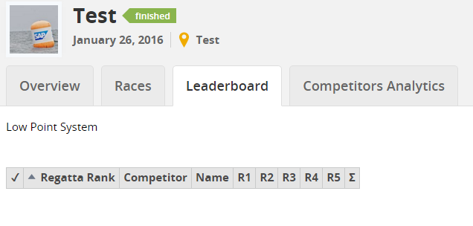
Enjoy Event Web Site
In the ”Events” tab click on event name link
This opens the event web site
Overview shows regatta
Generic event logo
Generic event stage image
Empty leaderboard with columns for races

Slide 24
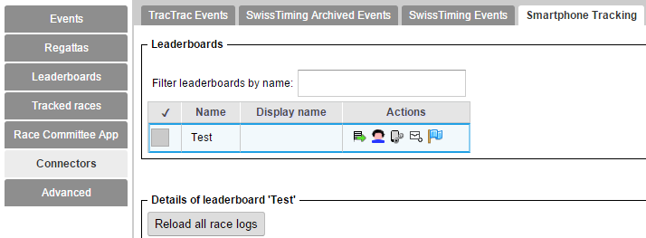
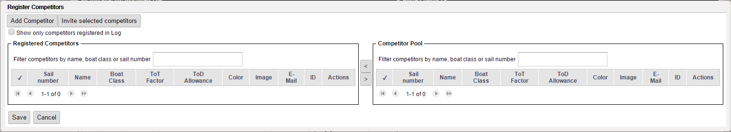
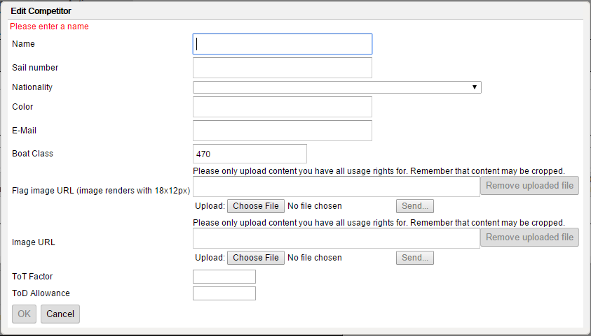
Adding Competitors
Go to Connectors→Smartphone Tracking
Click “Competitor Registrations” icon for leaderboard
Click “Add Competitor” and fill in at least
Name
Sail number
Nationality
E-Mail (if you want to invite the competitor to smartphone tracking later)
Boat Class (pre-filled from regatta data)

Slide 25
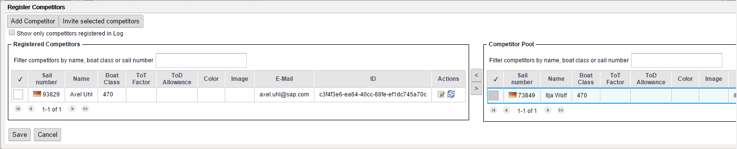
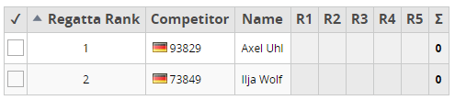
Adding Competitors (2)
Add more competitors, as required
Add existing competitors
Select competitor in the right table (1)
Press the “<“ button to assign competitor to leaderboard (2)
Leaderboard now shows the competitors
2
1

Slide 26
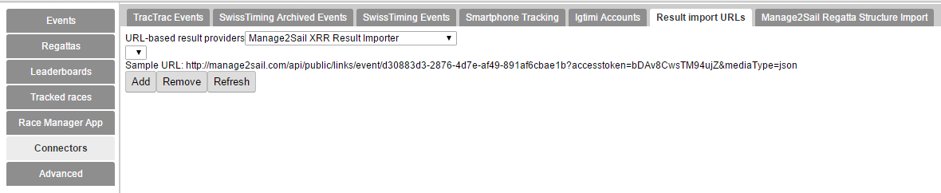
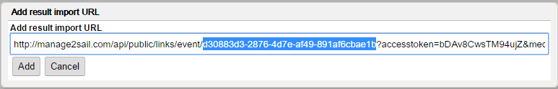
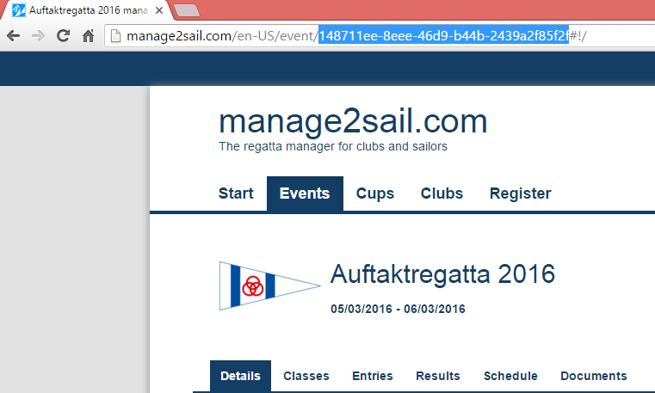
Configure Source for Competitor Import
Select “Manage2Sail XRR Result Importer” and copy the Sample URL, click “Add”
Replace event ID based on your Manage2Sail event ID

Slide 27
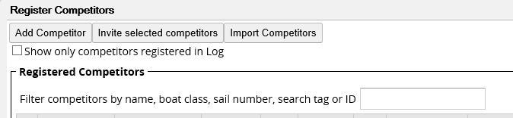
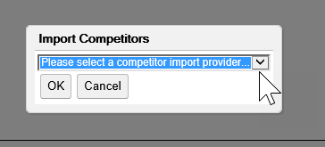
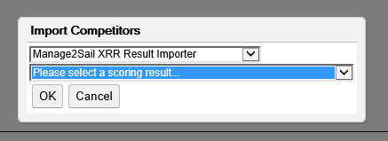
Importing Competitors (1)
Importing Competitors from External Regatta Management System (e.g., Manage2Sail)
Go to Connectors -> Smartphone Tracking
Click on “Competitor Registrations” icon for leaderboard (1)
Click on “Import Competitors” (2)
Select “Import Provider” and click “OK” (3)
Select “Scoring Result” and click “OK” (4)
1
2
3
4

Slide 28


Importing Competitors (2)
Select the competitors you want to import by clicking on them
Click “OK” to import
Imported competitors will appear in the “Registered Competitors” view
Click on “Save”

Slide 29

Matching import candidates with existing competitors
While importing competitors SAP Sailing Analytics will look for existing similar competitors in order to prevent unnecessary duplication of records
Competitors with possible matches are indicated in the “Has Matches” column
If you click on of these competitors the matches will be displayed in the “Existing Competitors” table
Select the existing competitor in the right table to use it instead of importing a duplicate

Slide 30



Entering Scores in Administration Console
Go to Leaderboards → Leaderboards tab
Click “Edit Scores” icon in the leaderboard’s row
Edit leaderboard contents as desired
Competitor’s display name (1)
Carry-over score (2)
Scoring code, such as DSQ, OCS (3)
Competitor’s score in race (4)
Update time (5)
Optional comment (6)
5
6
7
7
1
2
3
4
}
Click “Save” (7)

Slide 31
Questions?

Slide 32
Agenda
Introduction to SAP Sailing Analytics
Overview Functions, Features, and Architecture
First Steps in the Administration Console
Enabling Users
Creating an Event
Adding a Simple Regatta with a Leaderboard
Adding Competitors
Entering Scores
Using the Race Manager App
Binding a Device
Logging On
Planning and Running a Race
Regularly Updating Wind Data

Slide 33




Android & iOS Apps
SAP Sail InSight Buoy Pinging Race Management

Slide 34







Getting the Race Manager App for Android
Go to Race Manager App → Device Configurations tab
Click “Add Configuration” and enter Identifier
Click “Create”
Define course area name(s)
Each name must match exactly with event’s course area name
Click “QR-Sync”
Scan QR-Code with phone
Select “Open browser”
App download starts
Make sure your device allows apps from unknown sources to be installed
Install app by tapping on “download finished” message

Slide 35





Binding Race Manager App to Event
Launch the app
Starts out with a list of test events from a test server
From the “Settings” menu select “Synchronize with Server” (Note: this first binding step will soon be re-named and made simpler)
QR-Code Scanner will start
Take snapshot of Device Configuration QR-Code again
Confirm “Setup has changed” dialog
Log on to your event and course area with a position

Slide 36





Scheduling a Race
Tap the race (1)
Enter a start time (2)
Enter wind information (3/4)
Confirm Setup (5)
Race timing and flags will show
Change timing again by pressing the timing panel at the top
Update start procedure, course, wind or start flag by swiping timing panel to the left
Postpone, abort, recall or mark first finisher
1
2
3
4
5

Slide 37


Updating Wind Information
1
On the race sceen
Swipe the time panel to the left (1)
Tap on “Wind”
Enter wind data
Tap “Set Wind Data”
Do this frequently (every few minutes) for good results!

Slide 38






Finishing a Race
Tap the blue flag (1)
Enter the time of first ship home (2)
Tap “Down now” when last ship home (3)
Either take snapshot of hand-written finishing list (4)
Or enter finishing order here (5)
Tap competitor to add to result list
Switch to result list (on small device)
Long-press rank to enter OCS, …
Long-press handle and move
Optionally set protest time (6)
1
2
3
4
5
6

Slide 39
Questions?

Slide 40
Agenda
Advanced Event and Regatta Settings
Uploading Images and Videos
Using the Media Gallery
Setting Event Images for Stage, Logo and Teaser
Adding Video Playback to a Race Replay
Regatta Format and Scoring Options
Race Manager App Configuration (Start Procedures, Course Options, …)
Importing Results from an External Source (e.g., Manage2Sail)
Edit Mark Position Mask
Smartphone Tracking for Single-Fleet Regattas
Defining the Course Marks and Waypoints
Inviting and Binding Competitors’, Marks’ and Mark Layers’ Devices
Using the SAP Sail InSight Tracking App
Pinging Marks
Starting and Stopping a Race

Slide 41





Advanced Event Configuration
Edit the Event
Edit URLs
Edit Images and Videos

Slide 42


Uploading Images and Videos
Select type of image
Input URL
Just copy it if you have it,
Or upload a file. This will fill the URL field when upload is complete
Title, Subtitle and Copy- right are optional
Width/Height will be filled automatically
Select additional tags if applicable
Tip: press Ctrl-Space in “Enter tags for the image” field to see list of possible tags

Slide 43


Where Do the Images and Videos Appear on the Site?

Slide 44



Adding Video Playback to a Race Replay 1/3
Enter link to video (youtube or mp4) and name
(3)
(4)
(2)
(1)
With administrator permissions, use “Manage Media” to link videos to race
Video start time defaults to start of race

Slide 45

Adding Video Playback to a Race Replay 2/3
(1)
(2)
(3)
(4)
(3) Click on „Edit“ to decouple video and race replay. Utilize the time adjustment buttons to set the start time of the video.
(4) Move the slider on the timeline to the time point currently represented in the video window.
(5) Click on „Preview“ to recouple video and race replay. Click on „Save“ to store the change to the database.

Slide 46



Adding Video Playback to a Race Replay 3/3
Further explanations and helpful tips:
Choose easily identifiable events such as the start of the race or a mark rounding and match their time.
To enable exact matching of video material and race replay, use the time adjustment buttons in the video window.

Slide 47



Configuring Your Regatta
Set dates, course area and series configuration
Use “Add Series” for split-fleet set-ups
Configure series scoring options
Define fleets
Use “Rank” 0 for qualification series (Yellow/Blue/… fleets)
Use 1, 2, … for Gold, Silver, … fleets

Slide 48


Configuring Your Regatta – Options for Race Manager App
For non-default (P/I/Z/Black) start mode flags, change configuration
Choose how courses shall be designed in the app
Enable start procedure(s)
Activate/Disable individual recall (X will or will not be offered in app)
Choose specific start mode flags, such as “U”
Set cross-regatta defaults in “Device Configuration”

Slide 49
Result Import from External Regatta Management System
Select “Manage2Sail XRR Result Importer” and copy the Sample URL, click “Add”
Replace event ID based on your Manage2Sail event ID

Slide 50




Importing Scores 1/2
Click “Edit Scores” icon
Click “Import Official Results”
Select provider
Select result to import

Slide 51

Importing Scores 2/2
Assign imported scores to competitors / races
Suggestions for matching sail numbers (1)
Suggestions based on race numbers (2)
All suggestions can be changed at any time
Select all, none, all of a race or all for a competitor (4)
2
4
1
4

Slide 52


Editing Mark Positions
Requirements:
Admin permission
Race Status: Tracking
Go to “Events”
Select event

Slide 53



Editing Mark Positions (2)
Click on “Races” tab
Click on “Race Details”
Click on “Race Analysis”

Slide 54


Editing Mark Positions - Add new location fix for Mark
Click on “Edit Mark Positions“
Select the mark you want to edit
You will see all the location fixes for that mark
The line chart shows the deviation of the mark in reference to the average location over time – this helps you find outliers

Slide 55


Editing Mark Positions - Add new location fix for Mark (2)
Select time point at which you want to add the position on the timeline below the map by using the slider (1)
Mark position will be used from the chosen time point on, until a newer position is available
Click “Add new Fix” (2)
you can now move the time slider to see how the fleet sailed in reference to your new fix and change the position of the fix by dragging the map
Click „Confirm new fix“ to add the fix

Slide 56

Editing Mark Positions- Edit existing location fix for Mark
Click on mark whose location fix you want to edit
You will see all the available location fixes for that mark
Change location of the fix by dragging it with the mouse
An updated position fix with the same time point as the existing one is created which overwrites the old mark‘s position.

Slide 57
Questions?

Slide 58
Agenda
Advanced Event and Regatta Settings
Uploading Images and Videos
Using the Media Gallery
Setting Event Images for Stage, Logo and Teaser
Regatta Format and Scoring Options
Race Manager App Configuration (Start Procedures, Course Options, …)
Importing Results from an External Source (e.g., Manage2Sail)
Smartphone Tracking for Single-Fleet Regattas
Defining the Course Marks and Waypoints
Inviting and Binding Competitors’, Marks’ and Mark Layers’ Devices
Using the SAP Sail InSight Tracking App
Pinging Marks
Starting and Stopping a Race

Slide 59
Android & iOS Apps
SAP Sail InSight Buoy Pinging Race Management

Slide 60


Defining Marks, Control Points, and Waypoints 1/2
Enable Smartphone Tracking on Regatta (press the “Shortcut to denote all races for racelog tracking” icon)
For the first race, click “Define Course Layout” icon

Slide 61



Defining Marks, Control Points, and Waypoints 2/2
Add marks (1)
Assemble gates and lines from marks (2)
Combine marks, gates, and lines into waypoints (3)
Specify how the waypoint shall be passed (4)
Save the course (5)
3
2
1
5
4

Slide 62


Copy Course to All Races
Click “Copy course and competitors to other races” icon
Select races to copy the course to
Press OK

Slide 63



Invite Competitors to Bind their Devices
Click “Competitor Registrations” icon
Select all competitors to invite
All competitors selected must have a valid e-mail address configured
Click “Invite selected competitors”
Sends out e-mails with QR-code and link
Competitors scan it

Slide 64




Produce QR Codes to Bind Devices Used to Track Marks
Click “Map Devices to Competitors , Boats and Marks” icon
Click “Add”
Select mark, producing QR code
Scan code with
device used to
track mark

Slide 65





Enabling Use of Buoy Pinging App
Click “Invite Buoy Tenders” icon
Select event
Enter e-mail addresses for invitations
Click “Invite Buoy Tenders”
Scan code in app

Slide 66



Start Race Tracking, Set Tracking Times
Select race
Click “Start tracking” (1)
Click “Set tracking times” icon (2)
Enter at least a “Start of tracking” time
Alternatively to using Race Manager App, click “Set start time” icon (3)
Set race start time
Can be used to complement Race Manager app
3
1
2
1

Slide 67
Questions?

Slide 68
Agenda
Smartphone Tracking for Split-Fleet Regattas
Defining Series and Fleets in the Regatta
Assigning Competitors to their Fleet Races
Smartphone Tracking for Split-Fleet Regattas with per Race Boat Mappings
Register Boats for a Regatta with Split-Fleet Racing
Register Competitors with per Race Boat Assignments
Map Competitors to Boats per Race
Track Boats
Known Issues, Outlook
Importing Competitors from External Regatta Management System
Using Race Manager-Based Result Entry and External Scoring System
Correcting Wrongly Pinged Mark Positions
Obtaining the Apps
User Management

Slide 69




Defining a Series with multiple Fleets on Regatta creation
When creating a regatta, a default series with a single fleet is predefined. This can be deleted (1)
Click the “Add series” button to define a new series (2)
In the “Series” dialog, a default fleet is defined that needs to be deleted in the split fleet case (3)
Select a color & name (4), press “Add” (5). Repeat until all fleets are added (6), save (7)
Different series don’t need to have the same set of fleets (8)
2
1
8
4
5
6
3
7

Slide 70




Assigning Competitors to Fleet Races
Click “Competitor Registrations” icon (1)
Enable per-race competitor assignment (2)
Confirm (3)
Assign competitors to race (4), Save (5)
1
2
3
4
5

Slide 71
Agenda
Smartphone Tracking for Split-Fleet Regattas
Defining Series and Fleets in the Regatta
Assigning Competitors to their Fleet Races
Smartphone Tracking for Split-Fleet Regattas with per Race Boat Mappings
Register Boats for a Regatta with Split-Fleet Racing
Register Competitors with per Race Boat Assignments
Map Competitors to Boats per Race
Track Boats
Known Issues, Outlook
Importing Competitors from External Regatta Management System
Using Race Manager-Based Result Entry and External Scoring System
Correcting Wrongly Pinged Mark Positions
Obtaining the Apps
User Management

Slide 72




Register boats for a regatta with split-fleet racing
On creation of a regatta, select “Can boats of Competitor change per race” (1)
In “Smartphone Tracking” click the boat icon to open the “Register Boats” dialog (2)
Click “Add Boat” (3), fill in the boat details in the “Edit Boat” dialog (4) and Save (5)
After all boats are registered (6), Save (7)
1
2
3
6
4
7
5

Slide 73



Register Competitors with per race boat assignments
In “Smartphone Tracking” after denoting all races (1), click the competitor icon for a race to open the “Register Competitors” dialog (2)
Click “Add Competitor” (3), fill in the competitor details in the “Edit Competitor” dialog (4) and Save (5)
After all Competitors are registered (6), click “Continue to boat assignments” (7)
1
2
3
4
6
7
5

Slide 74

Map competitors to boats per race
Either directly after registering the competitors for a race or later by clicking the boat icon (1), the “Edit boats used by competitors” dialog is shown
Select a Competitor in the left table (2) and a boat in the right table (3) to assign those
After all competitors are mapped to boats, Save (4)
1
3
2
4

Slide 75

Produce QR Codes to Bind Devices Used to Track Boats
Click “Map Devices to Competitors, Boats and Marks” icon
Click “Add”
Select boat, producing QR code
Scan code with device used to track boat

Slide 76



Automated Pairing List Generation
1
Filter for the leaderboard
Click the “Pairing lists” action icon (1)
Competitor number should be filled; if not, choose one manually
Optionally, adjust the flight repeats number, reducing boat changes
Generate pairing list by pressing OK (2)
“Insert into regatta” to assign competitors to races and boats (3)
2
3

Slide 77
Agenda
Smartphone Tracking for Split-Fleet Regattas
Defining Series and Fleets in the Regatta
Assigning Competitors to their Fleet Races
Smartphone Tracking for Split-Fleet Regattas with per Race Boat Mappings
Register Boats for a Regatta with Split-Fleet Racing
Register Competitors with per Race Boat Assignments
Map Competitors to Boats per Race
Track Boats
Known Issues, Outlook
Importing Competitors from External Regatta Management System
Using Race Manager-Based Result Entry and External Scoring System
Correcting Wrongly Pinged Mark Positions
Obtaining the Apps (http://byc.sapsailing.com/apps)
User Management

Slide 78



Thank you
Contact information:
axel.uhl@sap.com

